Slide 1


Advanced User Interface - 2020-2021
Emotional storytelling
Group 13

Slide 2




The team
Group 13
Aida Denisa Opîrlesc
ID : 10735889
aidadenisa.opirlesc@mail.polimi.it
Master Computer Science and Engineering
Gerardo Frutos Dordelly
ID : 10692616
gerardo.frutos@mail.polimi.it
Master Design & Engineering
Akash Aloysius James
ID : 10687690
akashaloysius.james@mail.polimi.it
Master Computer Science and Engineering
Mélodie Marie Anne Jacob
ID : 10621817
melodie.jacob@mail.polimi.it
Master Design & Engineering

Slide 3

User
Target group
Aged from 6 to 12 years old
Unable to understand their emotion and other people’s emotion and adopt an appropriate response to a situation
Child can empathize with character, who encounter si- milar situation
May be unable to read, write
User needs
The child needs help identifying his emotions and un- derstanding them.
The child needs to practice their listening and spea king to better interact with society.
The child needs to put a lot of effort into understan- ding and managing their emotions.
Children need to learn to connect with individuals by empathizing with their circumstances.
The child’s privacy needs to be maintained.

Slide 4

Help children with cognitive disabilities understand and manage their emotions better, in order to better interact within society
Objectives
Understand the emotions of the children in order to better provide them with a personalized learning
Provide emotional education through storytelling
Improve the engagement of the child through interac tive storytelling (immersive content/experience)
Provide a more accessible tool to help children practice their emotional understanding in between therapy sessions.

Slide 5
PARENTS
CHILDREN
At Home
Have
STAKEHOLDERS
Physical Context
Need 1: The child needs to practice their listening and speaking to better interact with society
Have
Main Goal: To help children understandand manage their emotions better
Happens in
Satisfies
Satisfies
Constrains
Need 2: The child needs help identifying his emotions and understanding them
Objective 1: Understand the emotions of the children in order to better provide them with a personalised learning
Human resources:
2 engineers, 2 designers
NGR
diagram
Need 3: The child needs to put a lot of effort into understanding and managing their emotions
Objective 2: Provide emotional education through storytelling
Time: 2 months
Need 4: Children need to learn to connect with individuals by empathizing with their circumstances
Technology: Conversational agent/ emotion recognition
Objective 3: Improve the engagement of the child through interactive storytelling (immersive content / experience)
User: children with cognitive disabilities
Need 5: The child's privacy needs to be maintained
Privacy: protect the user data (personal and medical data)
Objective 4: Provide a more accessible tool to help children practice their emotional understanding in between therapy sessions.

Slide 6
REQUIREMENTS
FR1.The system should be able to engage in fluent conversations, directed towards the user's experience
FR7. The system should be able to narrate the story, pause it, ask questions and wait for the user's response to them, before continuing the story.
FR12.The system must have a predefined set of stories that are composed by sections that have description, questions, possible answers (suggestions), and the next steps (sections) that can be reached, depending on the emotion and the answer of the child.
FR2. The system should be able to narrate (audio) the messages that it communicates to the user
FR8. The stories should be interactive, include questions about the character's emotions or actions.
FR3. The system should perceive what the user is saying and act according to it.
FR9. The system should provide an explanation for why the user or the character in the story feels a specific emotion.
Requirements
diagram
NFR1: The system must store the user's activity and information securely.
FR4. The system should display the dialog between itself and the user.
FR10. The system should offer suggestions about how a detected emotion can be managed.
NFR2: The system must make use of a chatbot or conversational agent
FR5. The system should be able to detect the emotion expressed in the user’s messages.
FR11.The system must provide the child with the continuation of the story based on his previous answers.
NFR3: The right permissions must be given for the microphone by the user, in order to send vocal messages.
FR6. The system should be able to choose an appropriate story based on the detected emotions.

Slide 7
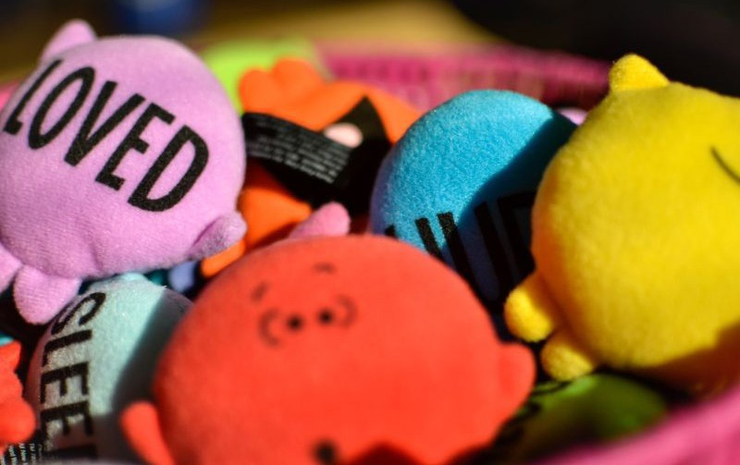
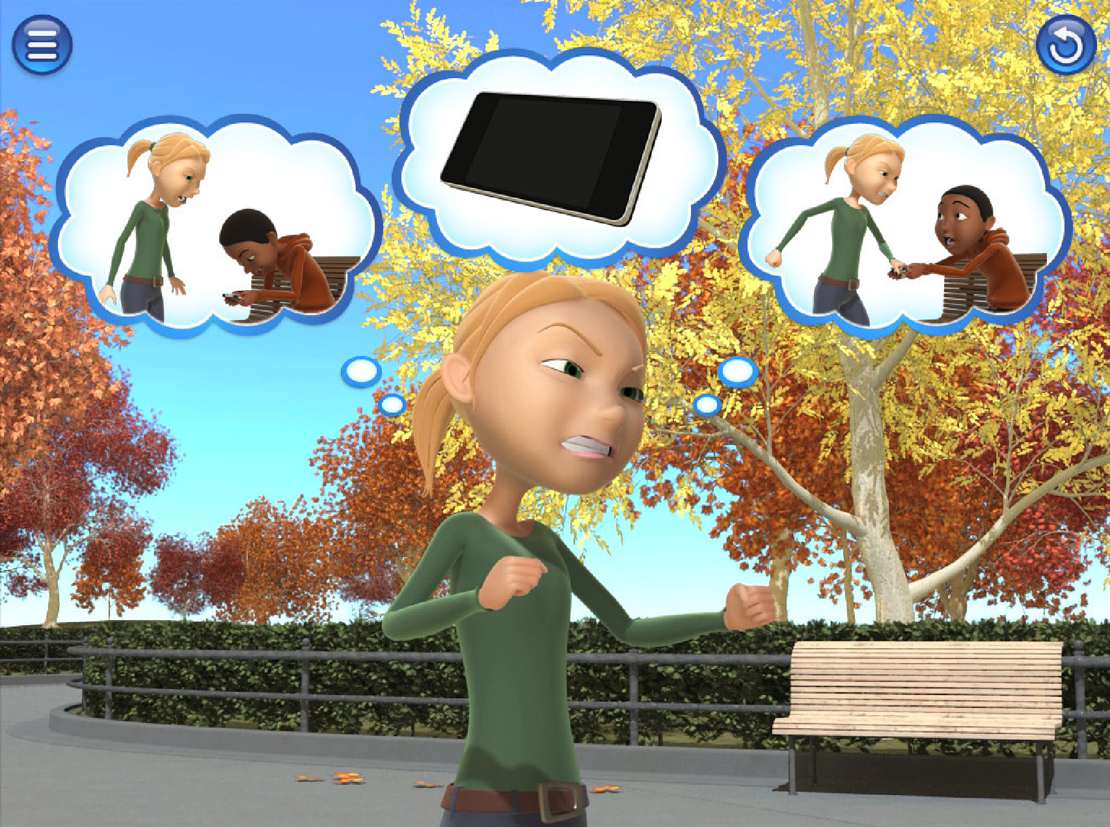
Emotional Storytelling using Virtua
Robotic Agents
Sandra Costa, Member, IEEE, Alberto Brunete, Member, IEEE
Byung-Chull Bae, Member, IEEE and Nikolaos Mavridis, Member, IE
Abstract—In order to create effective storytelling agents three fundamental questions must be answered: embodied agent preferable to a virtual agent or a voice-only narration? Second, does a human voice have a synthesised voice? Third, how should the emotional trajectory of the different characters in a story be relat facial expressions during storytelling time, and how does this correlate with the apparent emotions on the fac The results of two specially designed studies indicate that the physically embodied robot produces more atte
18 Jul 2016
as compared to a virtual embodiment, that a human voice is preferable over the current state of the art of t
State
of the art
Conversational agent & emotions
that there is a complex yet interesting relation between the emotion lines of the story, the facial expressio
agent, and the emotions of the listener, and that the empathising of the listener is evident through its facia
work constitutes an important step towards emotional storytelling robots that can observe their listeners and order to maximise their effectiveness.
Index Terms—Storytelling, robot and virtual agents, emotional affective response, eye blink analysis, facial e
[cs.RO]
non-verbal communication, posture analysis
✦
1 INTRODUCTION
Storytelling is a form of oral communication with pre- historic beginnings, which serves as a means of accul- turation as well as transmission of human history [1]. Traditionally, human storytelling has been one of the main means of conveying knowledge from generation to generation, but nowadays new technologies have also been used in this knowledge-sharing process [2]. A way to view the process of storytelling is the fol- lowing: First, the storyteller understands the narrative message that is conceived by the story author. Second, the storyteller delivers it to the listener in an effec- tive way. Unlike written narrative communication, however, where the author communicates with the reader through the implicit communication channel (real author -> implied author -> narrator -> narratee
-> implied reader -> real reader) [3], the storyteller performs storytelling face-to-face in real-time. Thus, the storyteller can infer whether the listener is paying attention to the story from the listener’s responses or back channels such as verbal responses (e.g., acknowl- edgement tokens such as yeah, uh huh, or mm hm)
[4] and non-verbal responses (e.g., head nodding, eye
-Make a converation more natural, realistic and warmer using a human voice for the chatbot
blinking, or smiles). When the ne
arXiv:1607.05327v1
(e.g., head down or blank expres
throughout the storytelling) are
nised, an effective storyteller wil
narration technique to capture the
- Materialise emotions through physical object or intangible tangible
While the storyteller’s narration various depending on the listene education, preferences, etc.), emot ther verbal or non-verbal) is a co effective storyteller.
The reader’s emotional respon story in text can be either inter Examples of “internal” emotions (
- Engage the child in the experience through interactive activites
identification or empathy with t
- Divide each activities in several substeps to adopt child’s pace.
which occurs when the reader ent
Examples of “external” emotion
and surprise which occurs whe with the narrative discourse struct In the same vein, the storyteller ca emotional responses either inter Specifically to arouse the listener’ responses, the storyteller can play gate of the characters or the narr enhance the listener’s external e the storyteller can pretend the emotional states (e.g., pretending
S. Costa is with the Department of Industrial Electronics Engineering, University of Minho, Portugal
E-mail: scosta@dei.uminho.pt
A. Brunete is with the Center for Automation and Robotics (CAR UPM-CSIC), Universidad Politecnica de Madrid, Spain
E-mail: alberto.brunete@upm.es
B. Bae is with the School of Games, Hongik University, South Korea E-mail: byuc@hongik.ac.kr
N. Mavridis is with the Interactive Robots and Media Lab (IRML) E-mail: nmavridis@iit.demokritos.gr
more or less in an exaggerated w
The storyteller agent or system
tener’s non-verbal responses us
devices. The detection of positive
indication of the listener’s satisfac
in the story. In this case the sto continue to tell the story with the

Slide 8
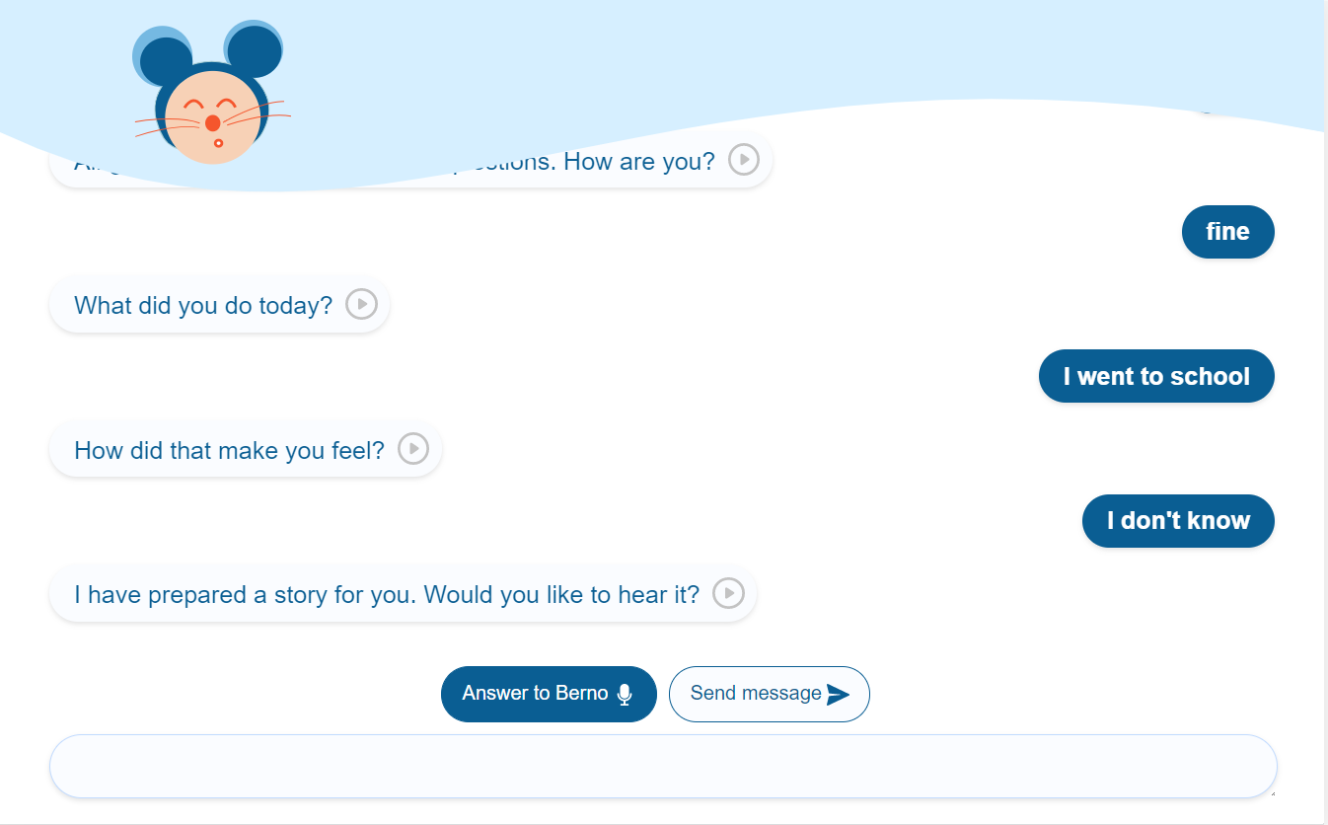
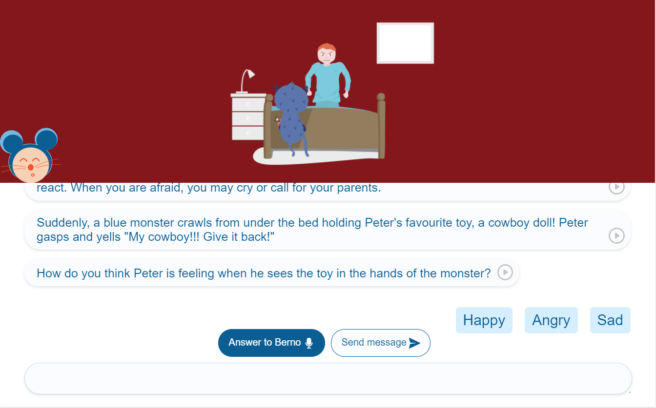
Open domain conversation view
Self-reflective
questions
UX design
Research & scenario
- Digital ethnography to try to understand child’s per ception
Open domain conversation
The story is divided is three parts :
Open domain conversation (listen and speak)
Story and activities (understand and empathize
Conclusion and toolbox (learn and reuse)
Multiple interactive activites :
identify an emotion
self-reflective questions
reaction suggestion activity
emotion-causing action
Story view
Emotion
identification
Answer suggestion
The child can answer using the microphone

Slide 9

START
START
Story Section 1: Emotion 1
Describe a new situation.
The character expresses one emotion
Are the last activity’s responses emotionally appropriate?
YES
NO
Story Section 2: Emotion 2
Story Section 2: Emotion 3
Diagrams
Hyperstory
& section structure
Activity 1: Emotion Identification
Activity 1: Emotion-Causing Actions
Are the last activity’s responses emotionally appropriate?
Are the last activity’s responses emotionally appropriate?
YES
NO
YES
NO
Activity 2:
Self Reflective Question
Story Section 3:
Emotion 4
Story Section 3:
Emotion 5
Story Section 3:
Emotion 6
Story Section 3:
Emotion 7
Activity 3: Reaction Suggestion
Story Section 1: Emotion Conclusion
Story Section 2: Emotion Conclusion
Story Section 3: Emotion Conclusion
END
END
Story section structure
Hyperstory

Slide 10
START
START
Description of characters and of a situation
Description of characters and of a situation
Question about identifying an emotion
Question about what character should do
next
Custom Answer
Ask Child for more details on his answer
The child answers
The child provides more information
Diagrams
Activity types
Suggested Answer
Emotion detection
Is the emotion correctly
identified?
NO
Encouragement to try again
Is the reaction suggested appropiate in the context?
NO
Explain why its Inappropiate
YES
Explanation about the emotion indentified
YES
Narrate appropiate action
Narrate the chosen action
STOP
STOP
Emotion identifying activity
Reaction Suggestion Activity

Slide 11
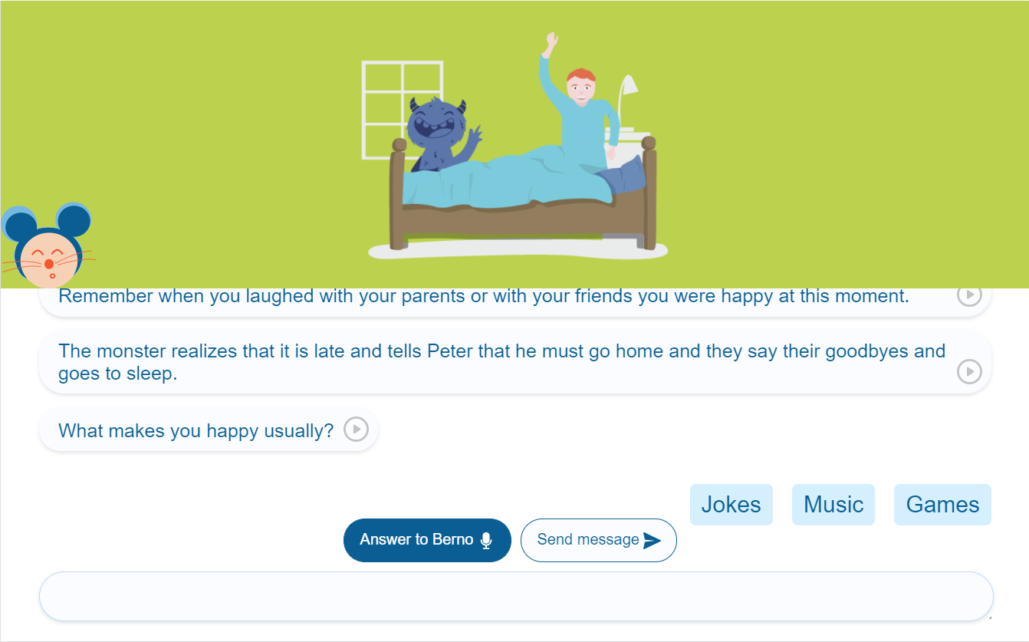
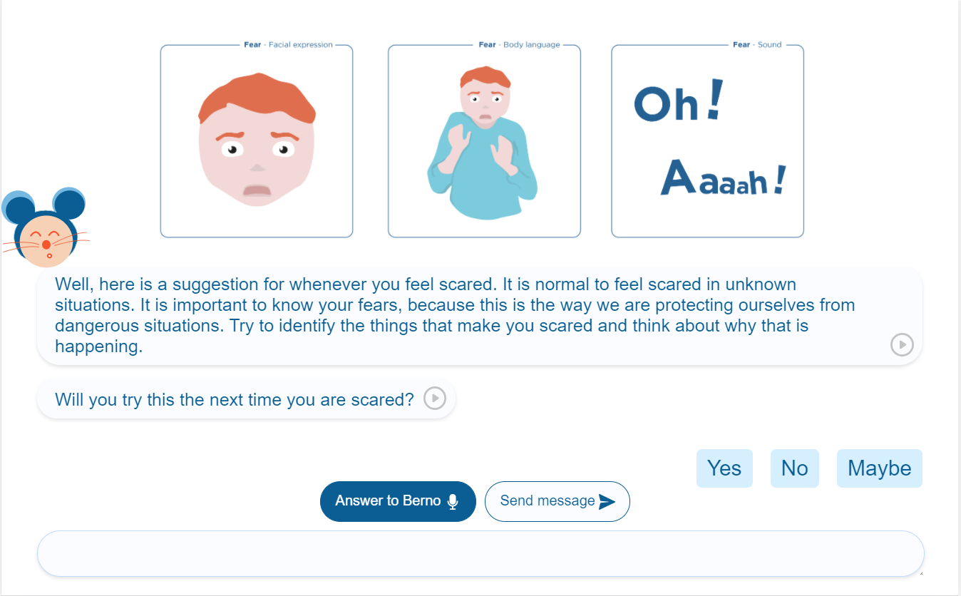
Colour of the back- ground changes according to the
emotion
UX design
Concept & interaction
The child can answer using the microphone
- Providing answer suggestion after 15 seconds of silence
- Associating one colour to each emotion
Answer suggestion after 15 secondes
- Highlighting character’s emotion (facial expression and body language) compared to useless details (back ground)
- The tablet offers a visual support to the conversation
Toolbox of emotions
- Flexibility of the interface to allow the parents to guide their child (replay answer)
Play button

Slide 12





Send User Message
Request or Update Data
Implementation
High Level Architecture
CLIENT APP
Respond with Chatbot Message
Return Data
DATABASE
Request Next Event
REST API
Send User Response
Vue.js - Handles the visuals and interface of the application
Respond with
Next Event Send User
Response
Return Emotion
BACKEND API
Node.js with Express.js - Handles the functionalities and external services to provide the data to be displayed.
Send Chatbot Response
Send Chatbot Message
Send Audio Buffer
Respond with Audio Buffer
Respond with Text Transcription
PostgreSQL with Knex - Handles the storage and extrac tion of relevant information to a database.
Google Speech-to-text
SERVICE FOR TRANSCRIBING MESSAGES
Google
Text-to-Speech
SERVICE FOR PLAYING MESSAGES
Heroku - Handles the deployment of the application on to the internet.
CHATBOT ENGINE
EMOTION DETECTION SERVICE
Architecture schema

Slide 13
CLIENT APPLICATION
Vue.JS Application
ASSETS
Vue Router
App.vue
Vuex Store
index.html
PAGES
Diagram
Front end
StoryPage.vue
main.js
- Vue.JS application
COMPONENTS
StoryCover.vue
StoryPage.vue
InputMessage.vue
- Separation of concerns achieved through components and services
BACKEND
variable.css
Message.vue
- Communicates with the back- end through HTTPS requests
SERVICES
HTTPS REQUEST
audio.js
bus.js
api.js
RESPONSE

Slide 14
Diagram
Back end
SERVER APPLICATION
IBM WATSON
Natural Language Understanding
ROUTERS
Conversation Route
Session Route
Speech Route
Webhook Route
Google SpeechToText
- Node.JS application with Ex- press and Knex
HTTPS REQUEST
FRONTEND
Index.js
SERVICES
- Offers a REST API interface for communication with Dialogflow and the client app
RESPONSE
Conversation Service
Speech Service
WebHook Service
Google TextToSpeech
DATABASE
CONFIG
Session Service
Emotion Detection Service
- Has 3 layers: routers, services and data layer
connection.js
Google Dialogflow
MIGRATIONS
- Uses external services through HTTPS requests or libraries for chatbot’s engine, speech transla- tion, emotion detection.
SEEDS
DATA LAYER DA0
Request or Update Data
Intent DAO
Session DAO
Conclusion DAO
Story DAO
DATABASE
knexfile.js
Return Data

Slide 15

Value proposition
How it helps children ?
Personalized experience based on the detection of the emotion expressed in the child’s answer
Adapting the story according to the child needs (appropriate reaction, identify emotion, manage emo tion)
Interactive activities adapted to child’s understanding of the emotions and actions
Raising awareness about other people’s feelings, by as- sociating real-life events with the stories and characters

Slide 16
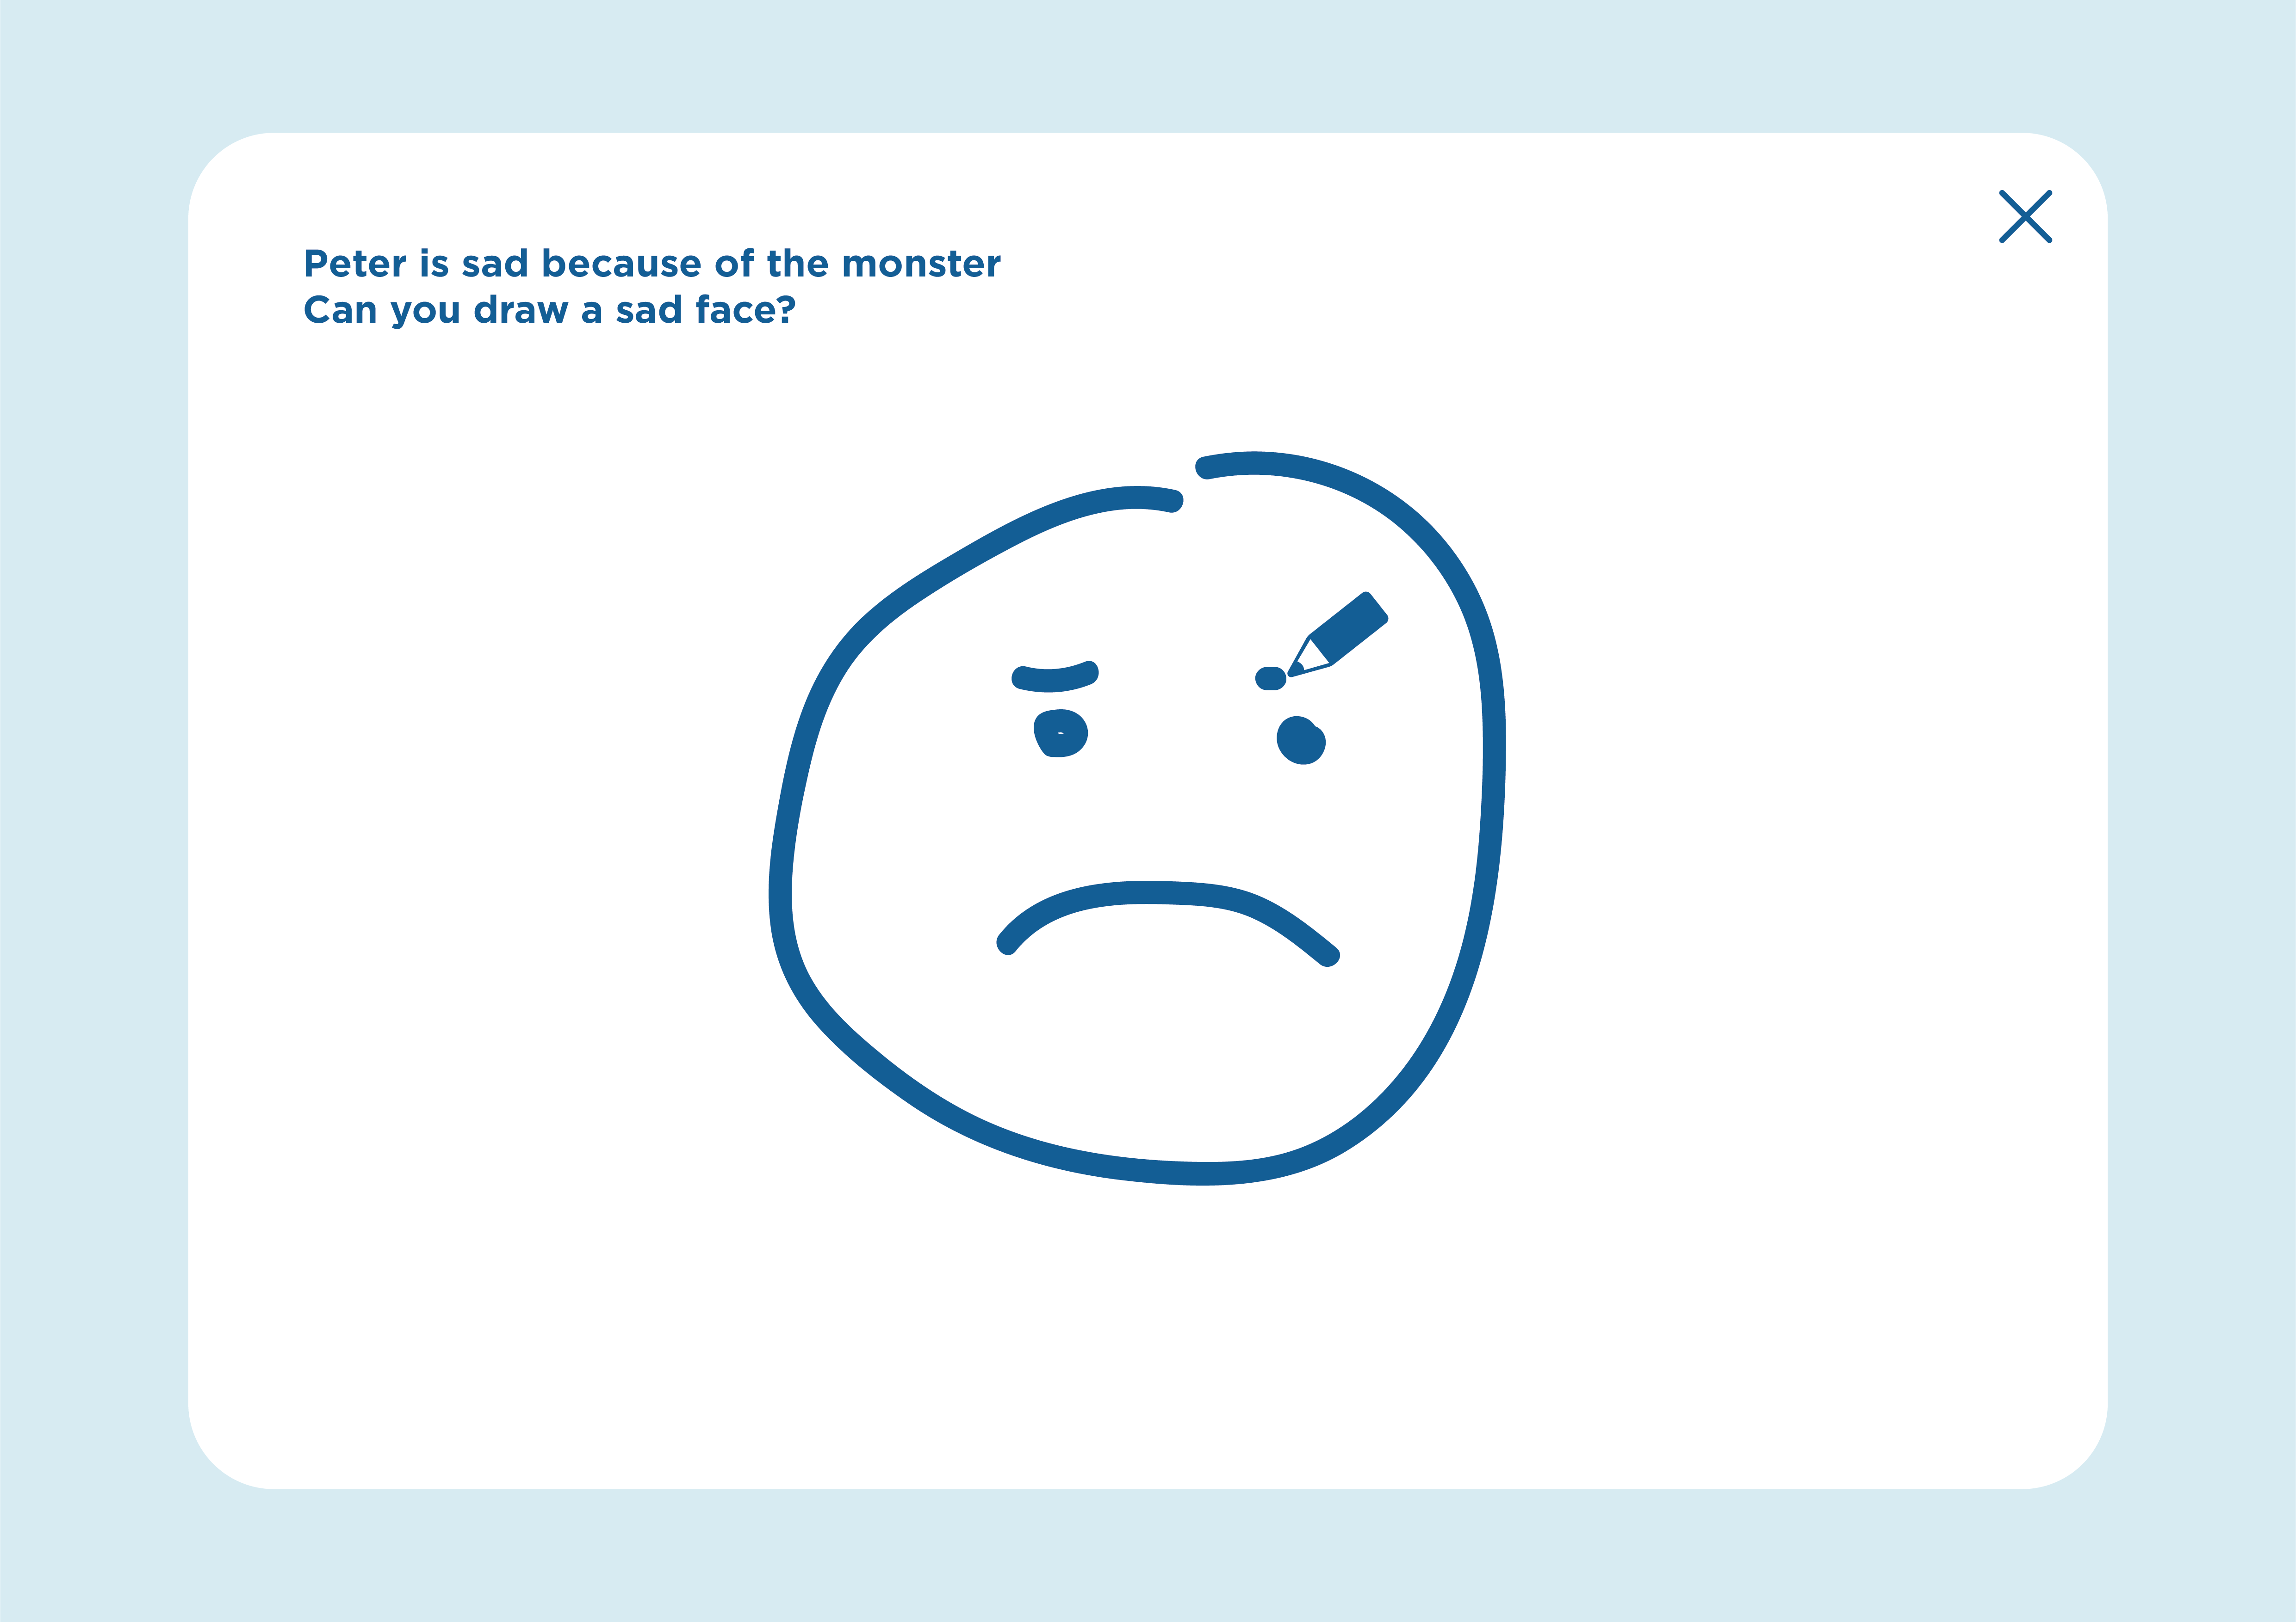
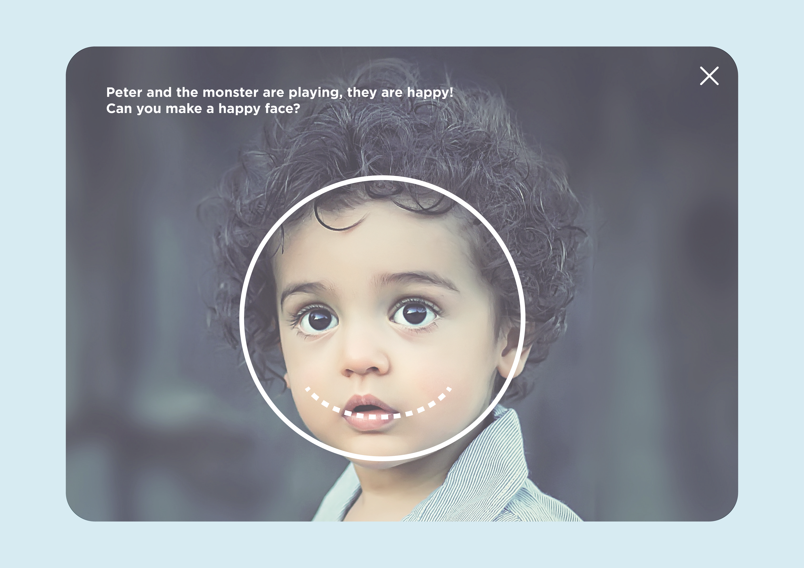
Future work
Drawing based recognition
(1st level)
Improvements
- Creating more engaging games by diversifying the formats of the activities
Offering different level of emotion identification based on :
Drawing (simplified representation)
Photo (realistic representation)
Video (real-life situation)
Imitating (reproducing an emotion)
Improving emotion detection (voice, face recognition, eye tracking)
Giving a role to the therapist (create and customized stories according to child needs)
Imitating an emotion (4th level)

